Slide 1


Antonio Cardona
Nathan Finley
Nicole LoGiudice
Demo Presentation
GrAPE (Graphic Analog Portable Equalizer)
Team #6
Notes:
template slide

Slide 2

Project Summary
Graphic Analog Portable Equalizer
Problem Statement
The current market lacks equalizers that can be used in settings where complete wirelessness is needed.
Without both bluetooth input and output connectivity, a user is unable to control his/her speaker system settings on-the-go, and must instead have a dedicated location next to a speaker system from which to control a sound system.
Solution Proposal
The GrAPE is a graphic analog portable equalizer for the frequency range of 0-20 kHz with the ability to connect via Bluetooth or Auxiliary to any device/speaker with
these applications.
Notes:
Talk about what an equalizer is
Problem Statement about equalizers

Slide 3
Subsystem Partition
Antonio Cardona: “Power Supply including: DC-DC converters, charging circuit and battery fuel gauge, and User Interface including LCD and directional buttons”
Nicole LoGiudice: “Bluetooth input and output, utilizing external DAC and internal ADC via I2S.”
Nathan Finley: “”
Notes:
template slide

Slide 4
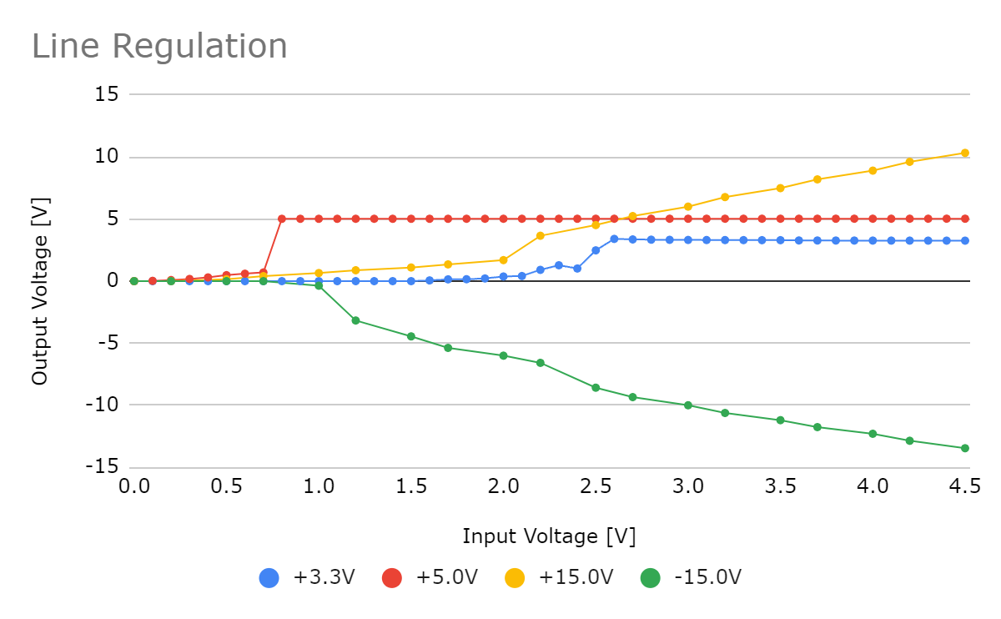
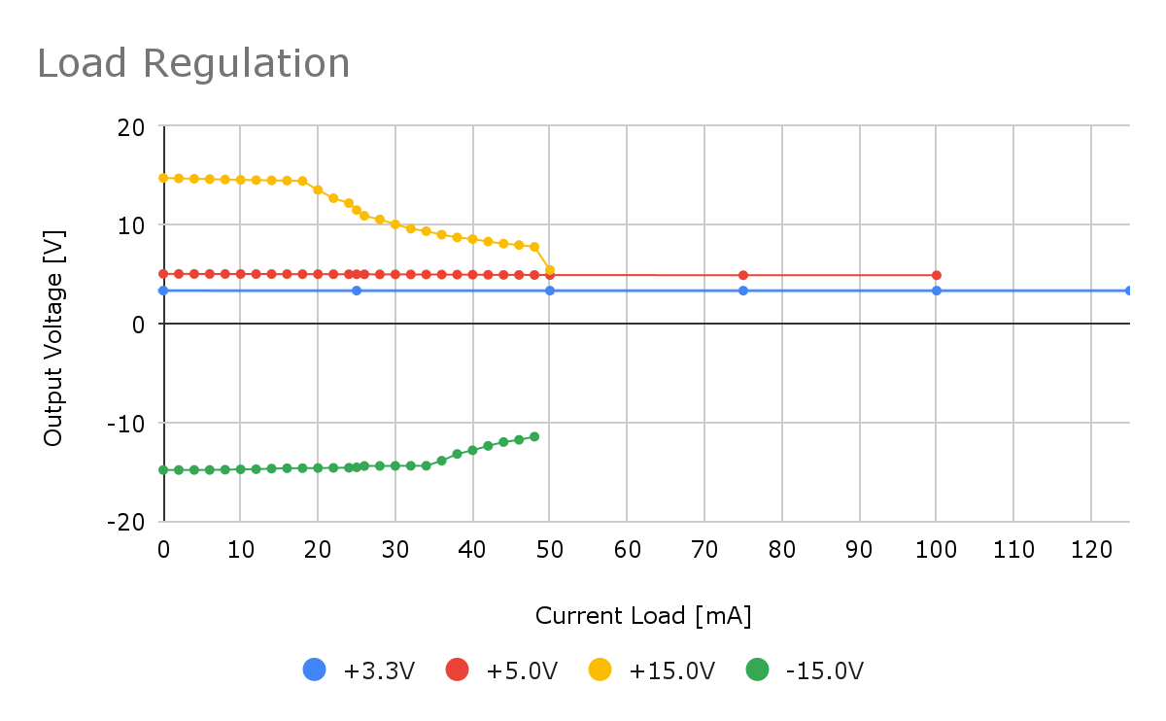
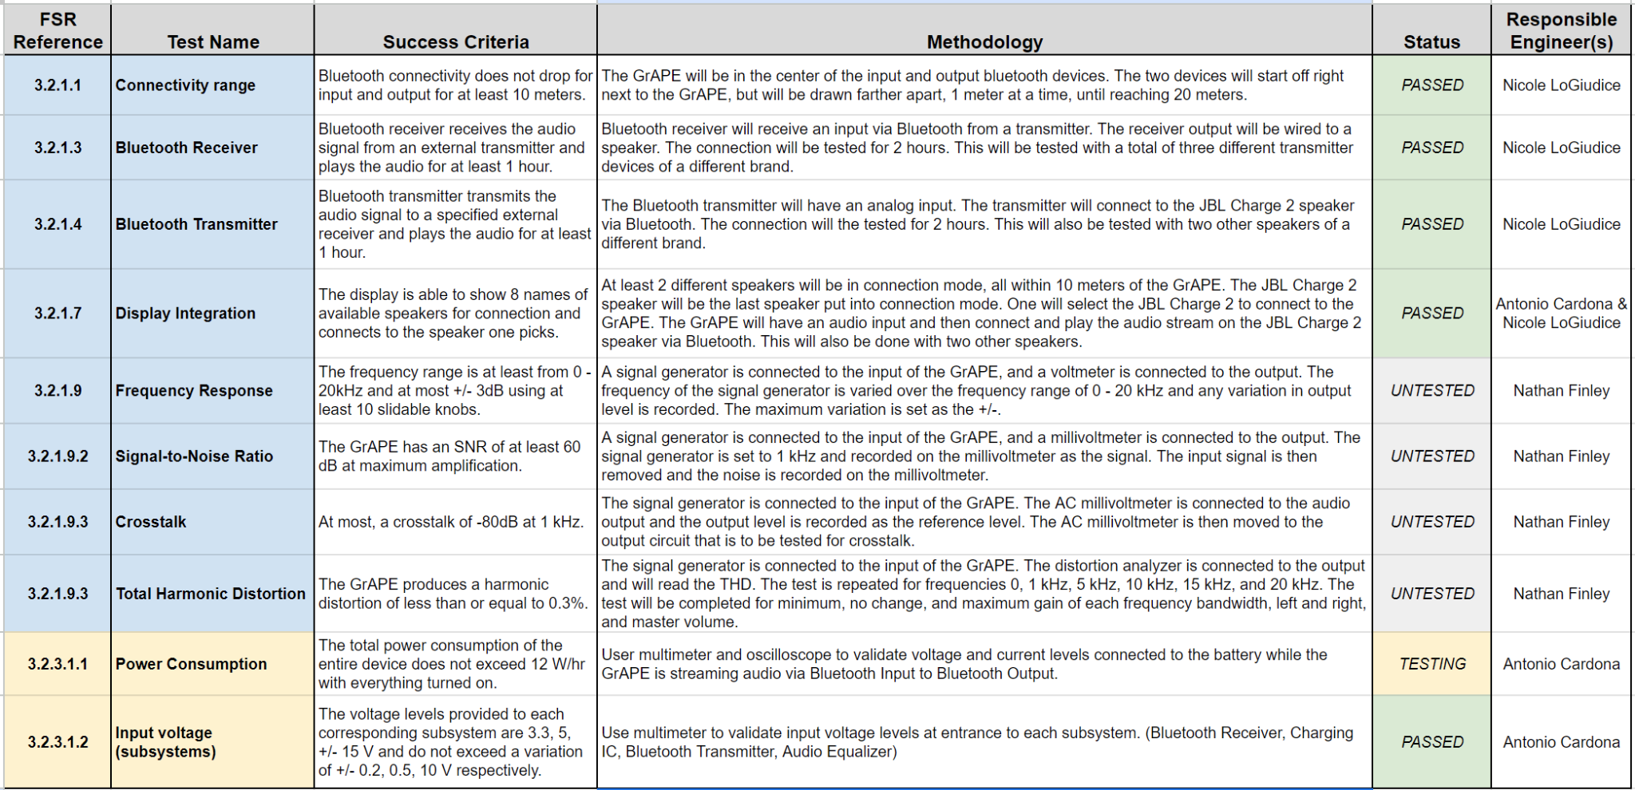
Antonio Cardona
Power Supply Validation
DC-DC Converter Detailed Validation Data
Notes:
Add pictures of ordered parts.

Slide 5
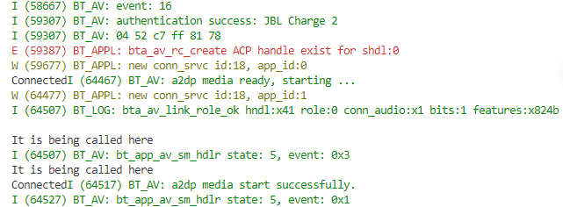
Antonio Cardona
LCD Validation
LCD Validation Demo
Notes:
Add pictures of ordered parts.

Slide 6
Nicole LoGiudice
Bluetooth Validation
Receiver | Time to Show on Phone (s) | Time to Connect (s)
1 | 3.35 | 4
2 | 3.44 | 3.95
3 | 2.69 | 4.41
4 | 2.33 | 3.75
5 | 2.23 | 3.13
Average | 2.808 | 3.848
Transmitter | Time to Show Receivers on Screen (s) | Time to Connect (s)
1 | 25.26 | 12.04
2 | 31.09 | 12.07
3 | 22.19 | 11.42
4 | 20.7 | 12.6
5 | 20.72 | 12.54
Average | 23.992 | 12.134
Connection Distance/Duration | Stable Connection Distance (m) | Stable Connection Time (hr)
Receiver & Transmitter | 20 | 2
Notes:
Add pictures of ordered parts.

Slide 7
Nathan Finley
Equalizer Validation
Notes:
Add pictures of ordered parts.

Slide 8
Validation Plan
I added this bc I think we should have the full validation plan on this, and show what was completed all year. Also these validations for the housing we could do before demo. Gl <3

Slide 9
What we would do differently
Use easier to solder components for ICs
Account for the worst case scenario for current load when designing the power supply
Use external ADC and potentially a different Bluetooth Module for audio transmission
Notes:
Add pictures of ordered parts.

Slide 10
Any Questions?

